Slide 1



Meet the Teacher
2018
Class: 4B
Teacher: Mr Bentley

Slide 2

Content
Class Specific Information
  Meet the teacher
  Timetable
  Homework
  P.E.
  Year Group Expectations
  Curriculum for this term
  Trips planned
  Concerns / Issues / Phase Leader
  Photo permission reminder
School Information
  Website
  Clubs

Slide 3
About me…
Over the last two years at this school I have taught in Nursery through to Year 6
Last year I was designated to Year 4 as well as responsible for planning and delivering the RE curriculum to lower KS2.
I previously worked in High Schools and taught Year 7 to 10 working specifically with SEND.
I enjoy working with children who find learning a challenge and I have a strong interest in SEND.
I am a registered member of The British Psychological Society and a qualified test user.
I am a keen cyclist and take part in a number of cyclo-sportives each year.

Slide 4
Supporting adults in the class…
At present we are fortunate to have Mrs Yates in class with us before she leaves to have her baby around October Half-Term.
HLTA – Mrs Greig
Teacher – Mrs Shinkins (Tuesday PM)

Slide 5
Welcome to Year4
Same as the last year group? | Different from your child's last year group?
The children! Expectations (e.g. homework, school rules) Reading Comprehension Handwriting | Curriculum Adults The classroom

Slide 6
Timetable (Key Facts)

Slide 7
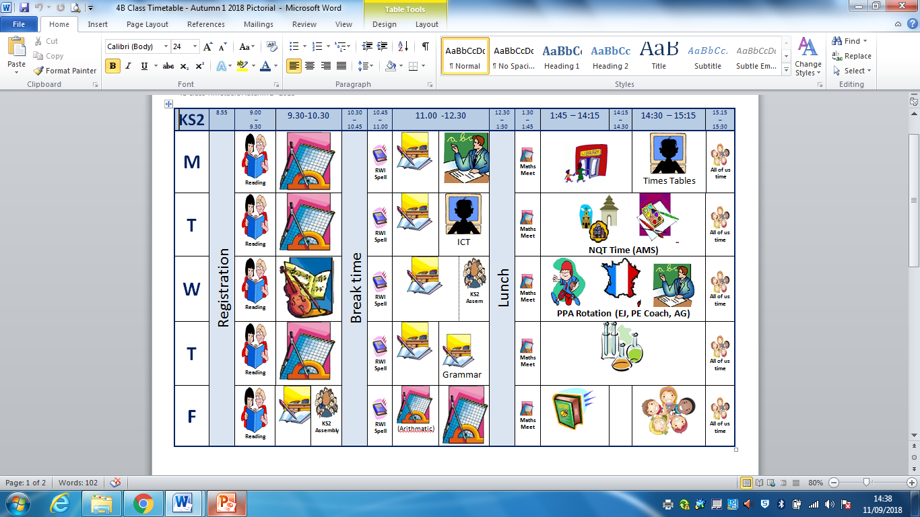

Slide 8




Homework
  Spellings – We will be teaching and practicing spelling patterns in class. Each week we will send home 10 spellings from the KS2 National Curriculum word list.
  Topic homework continues and can be found on the school website.
  Weekly reading expectations are 5x per week and can be recorded in your child’s Reading Record.
  Interactive Resources (which is detailed on the website) can can be accessed for maths activities.

Slide 9
Topic Homework
Children should choose at least 1 activity per half term from the homework list. This can be found on the school website, but a paper copy will also be sent home.

Slide 10
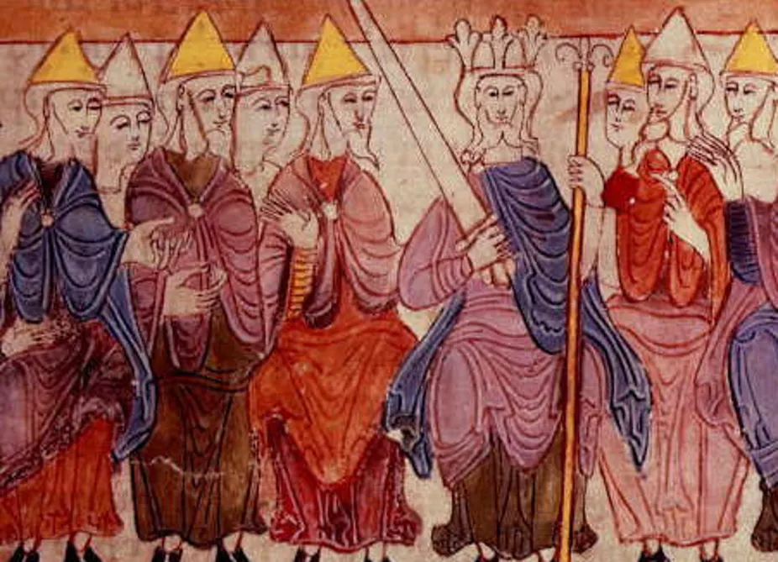
Year 4 Homework – Anglo-Saxons
Please complete a minimum of one task per half term, but of course you may complete as many of the tasks as you like. You can present your work in any way you wish. We look forward to seeing some of your amazing creations. Have fun!
Skill | Option 1 | Option 2
Talk | Anglo-Saxons liked to gather in the lord's great hall, to listen to songs and stories. A favourite story told was Beowulf. Research this tale and retell the story to a member of your family. | Discuss the positive and negative impacts of invaders and settlers throughout history.
Research | Research the origins of Anglo-Saxons words and place names in East Anglia. | Early Anglo-Saxons wrote using letters called runes. They believed runes had magical powers. Research the Futhark alphabet (runes). Can you write your teacher a message in Futhark?
Create | Create your own Sutton Hoo helmet, mask or shield using whatever materials you have. E.g. card or papier mache . You could also decorate it using tin foil or buttons. Look at the one found at Sutton Hoo for inspiration! | Men and women wore jewellery such as brooches. Women used these to fasten their dresses at the shoulders whilst men used them on their cloaks. Make your own Anglo Saxon styled brooch; choose any suitable material such as clay , salt dough or card.
Understand | Who was Alfred the Great and why was he considered so ‘great’? | Compare and contrast life today with life in Anglo-Saxon times. How has Anglo Saxon life influenced our lives today?
Experiment | Anglo-Saxon lords were expected to entertain their followers with feasts. Look up an Anglo-Saxon recipe and try and make it to share with your family or class. | Can you survive without electricity for an evening? Write about your experiences!
Reflect | Imagine your country has been invaded. How would you feel and what would you do? Record your thoughts and concerns in a diary entry expressing your feelings. | What are your top five fascinating facts about the Anglo-Saxons? Would you like to have lived during Anglo Saxon times? Present this creatively.

Slide 11
Year Group Expectations
  The next slides detail the End of Year 4 Expectations for reading, Writing and Numeracy.
  You are welcome to take a leaflet detailing these home.

Slide 12

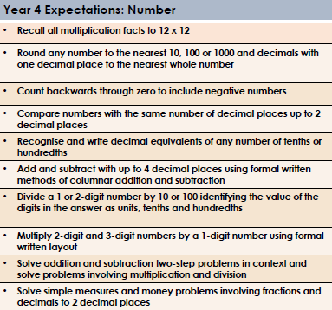
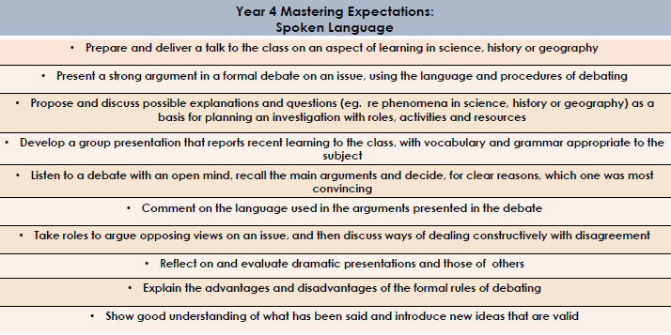

Maths
End of Year 4 Expectations
This booklet includes the end of year 4 expectations for children in our school based on the new National Curriculum. These are the minimum requirements your child must meet in order to be graded as working at ‘National Expectation.’
All the objectives will be worked on throughout the year and will be the focus of direct teaching. Any extra support you can provide in helping your children to achieve these is greatly valued.
If you have any queries regarding the content of this booklet or want support in knowing how best to help your child please talk to your child’s teacher.
Spoken Language

Slide 13

Reading
Writing

Slide 14

P.E.
Remember…
The office will no longer phone home if children forget their P.E. kits. Children are NOT allowed to borrow kit from other children.
PE kits should remain in school but will be sent home half termly to ‘freshen up’.
PLEASE NAME ALL ITEMS

Slide 15
Trips Planned this term
  Please note: -
  Across the course of the school year, the school intends to increase the amount of trips for the children. Whilst the school will try to ensure that some of these trips will be free, some inevitably will require a parent contribution. The school is able to subsidise some of these trips, however, without your support we may have to reduce these down.
  Children will be given opportunities to carry out fundraising activities in order to bring the overall cost of trips down.
  All trips planned link directly to your child's learning.
  West Stowe Anglo Saxon Village (01/11/2018)
  Proposed overnight trip linked to Tudors during the Summer Term.

Slide 16
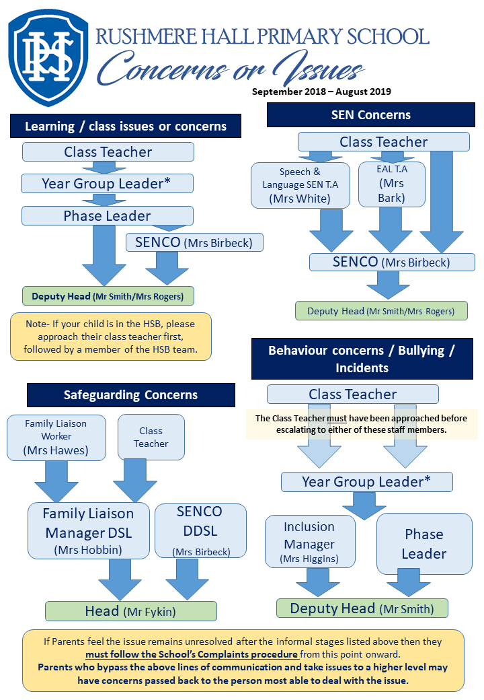

Slide 17
Getting a chance to speak to us…
After school is best.
Messages can be given to any adults who are on duty in the morning.
Notes can be passed to the class teacher at the beginning or end of day.
Emails via the main office.

Slide 18
Photo Permission
  No longer doing this by opt out.
  Forms will be available at the end of the meeting for parents to complete.
  Your child's name is already printed on the form to save time.
  Please hand back to the class teacher OR the school office ASAP

Slide 19
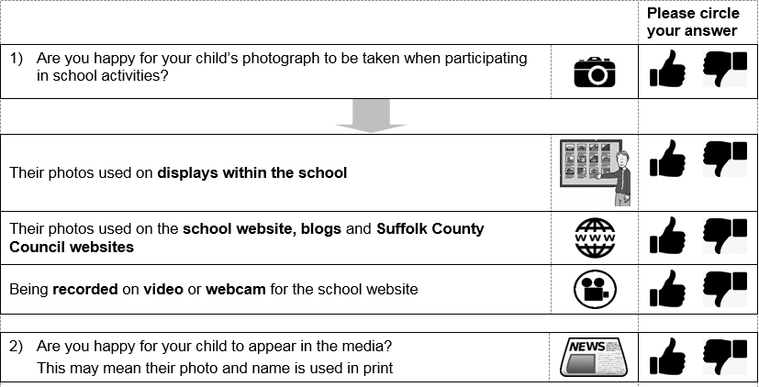
Photo Permission
Basically… if you are happy for your childs photo to be used… please circle as shown here.

Slide 20
Photo Permission
If you select NO on question 1 … please do not answer the remaining questions

Slide 21
Website
www.RushmereHallPrimarySchool.com

Slide 22
Volunteers
Sign up to what you can offer…
Signing up doesn’t mean we will take up your services!
DBS check will be needed
We will try to cater for all offers… however, there are some occasions / lessons where too many adults may be a hindrance.
Potential key areas of need – Parent Readers, Art lesson support, resourcing, improving learning areas in the school.

Slide 23
Class: __________________
Leave name
Contact number
Volunteers
 | Mon | Tue | Wed | Thu | Fri
AM
PM
Sign up to what you can offer…
DBS check will be needed

Slide 24

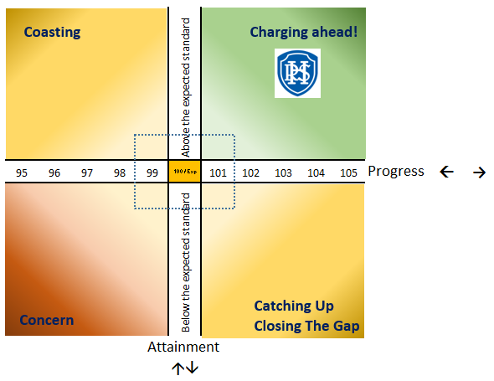
Reporting Assessment & Progress
Three times a year parents will receive progress reports (2 x Parents’ Evening and Year End reports).
The report will show which of the four quadrants your child is working within. The aim to be working in the green quadrant, however some children may be working in the amber or red section.

Slide 25
Writing Expectations
The next slide is an example of the level a child needs to be writing at to achieve the year group expected standard.
Standards have gone up nationally.
There is a greater focus on the technicalities : - punctuation, grammar, spelling etc

Slide 26
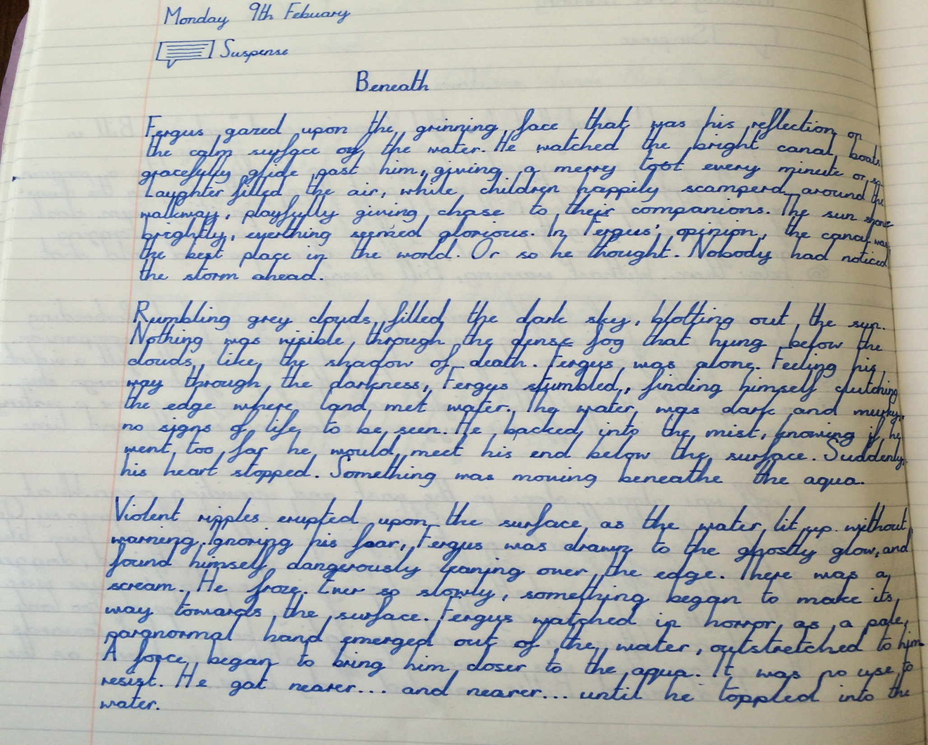
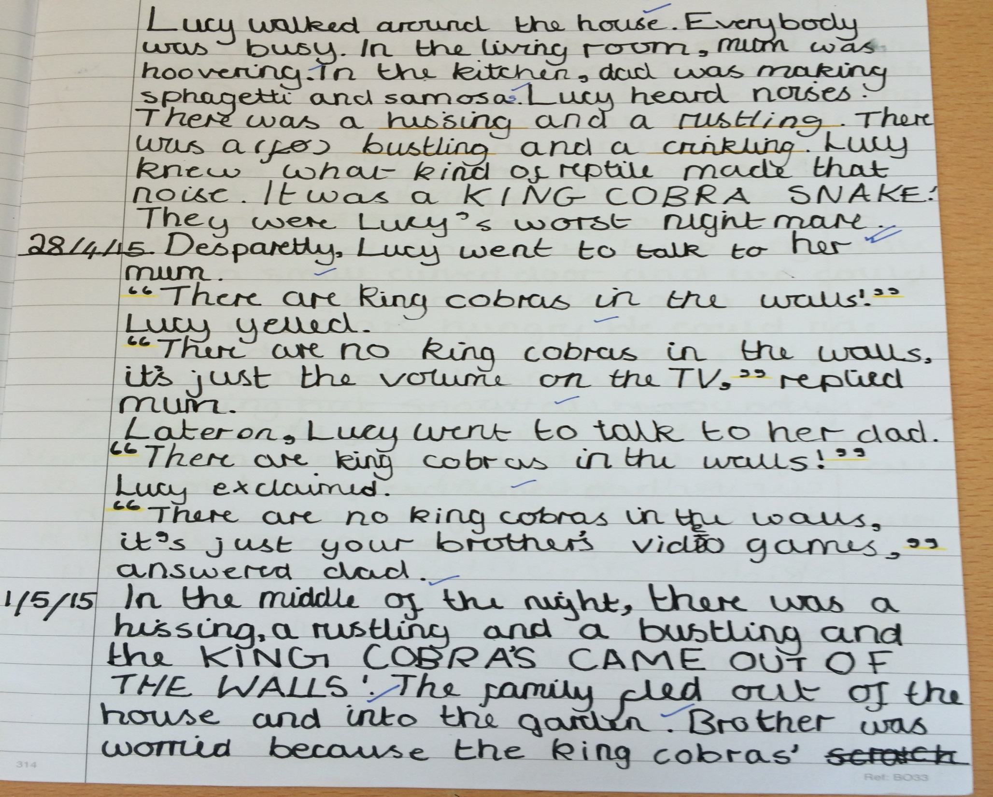
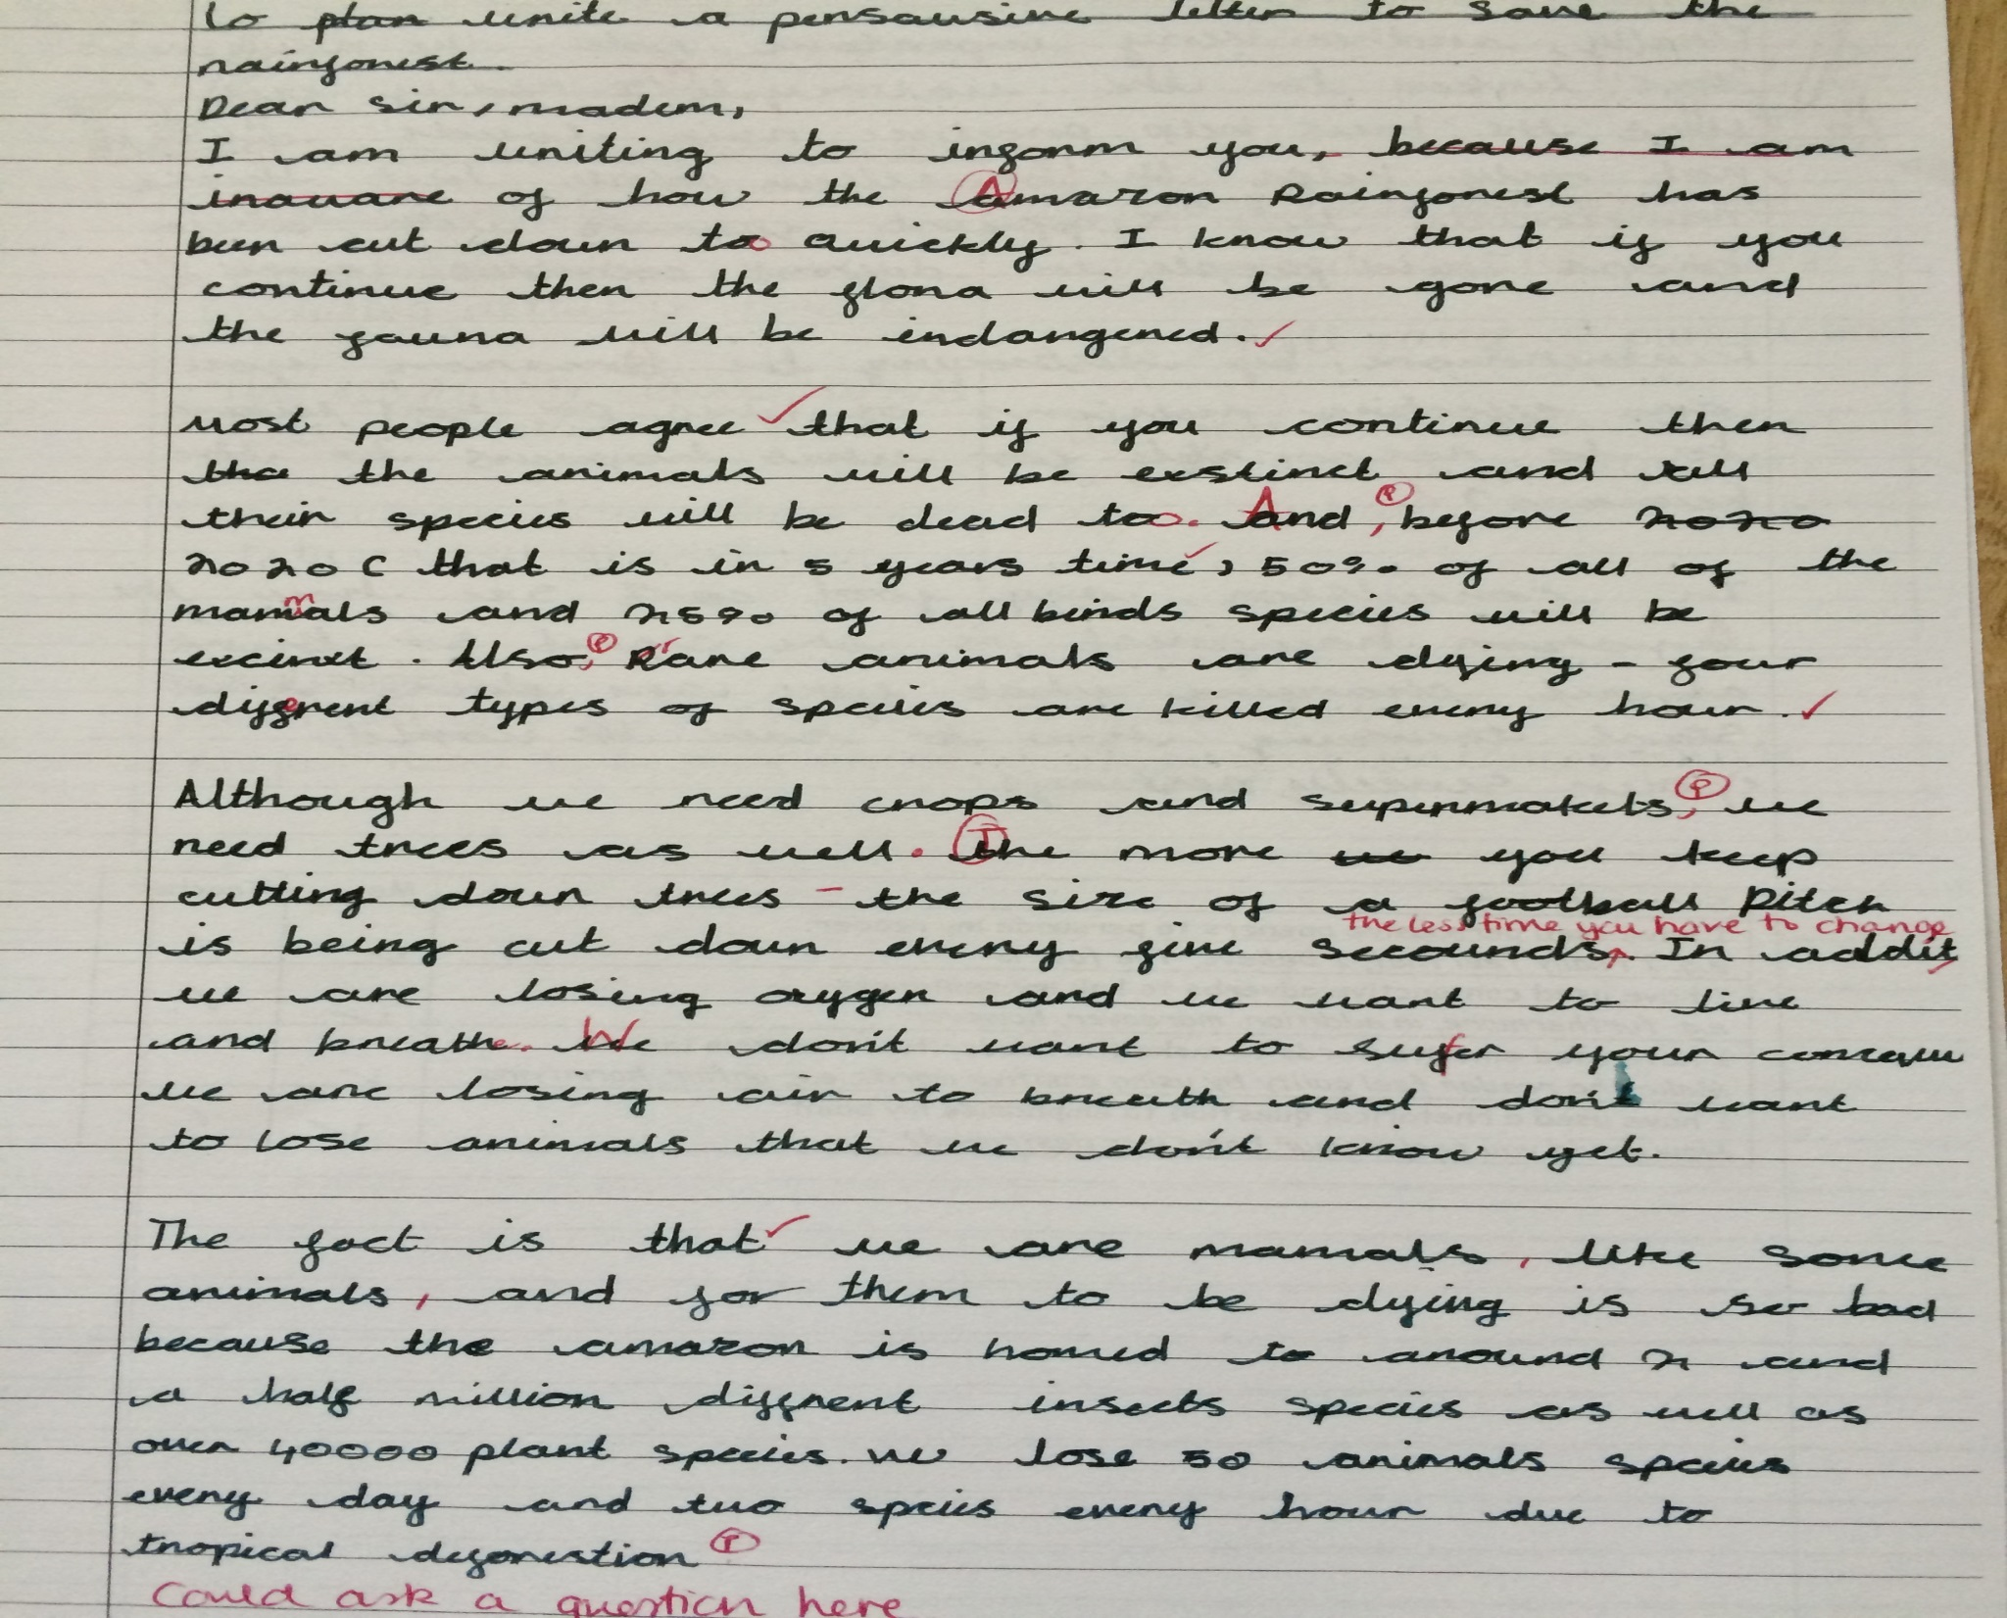
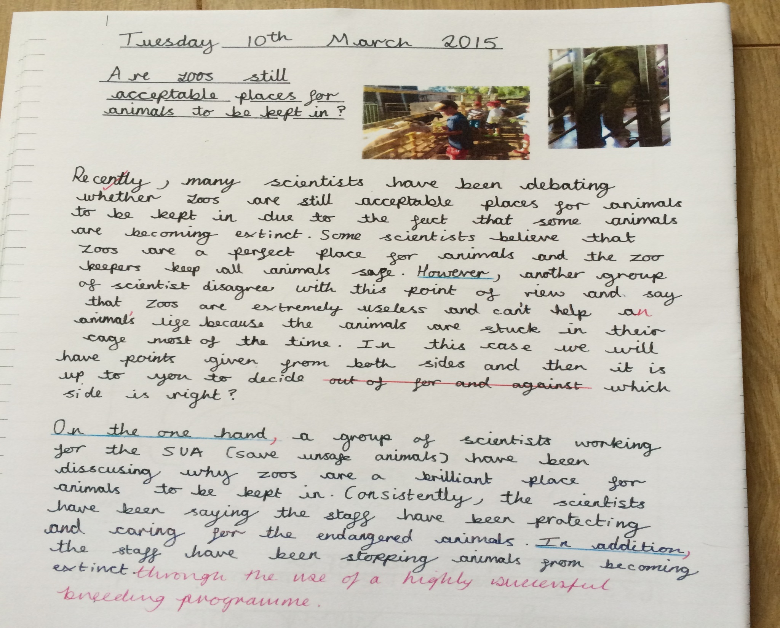
Sign up to what you can offer…
Signing up doesn’t mean we will take up your services!
DBS check will be needed
We will try to cater for all offers… however, there are some occasions / lessons where too many adults may be a hindrance.
Key areas of need – Parent Readers, Art lesson support, resourcing, improving learning areas in the school.
Expectations YEAR 4

Slide 27
Reading
Each child has been issued with a library book and a reading book along with a Reading Diary for recording their reading at home.
The children will have an opportunity to change these weekly during their allotted library slot.
1 to 1 reading is not timetabled. Focus is on comprehension via 5 x 30 minute daily Reading comprehension sessions and Literacy lessons.
Just 5 minutes listening with each child read equates to approximately 2.5 hours each week!

Slide 28

Report all child protection concerns to an adult >> preferably those listed on the following page.
However small the information may be, we may already have other information about the child.

Slide 29

Designated Safeguarding Lead
The school’s DSL is Ms Rachel Hobbin
The DDSL is Mrs Helen Birbeck (SENCO)
The Governor(s) responsible for Safeguarding are Mr Alex Davison (Chair of Governors) and Mrs Moira Bryan (Safeguarding Governor).

Slide 30
A few reminders…
Children need to bring a separate snack for break times (lunch boxes are kept separately and are not accessible during the day).
No pencil cases – children are provided with everything that they will need.
Named water bottles are encouraged to be kept in the classrooms.

Slide 31
?
Any questions?

