Slide 1
Rushmere Hall
Year 6 Residential Visit
PGL – Bawdsey Manor

Slide 2
The Location
PGL’s newest centre, Bawdsey Manor, in Suffolk, is a stunning place!
Bawdsey Manor is a Grade II* listed, private site, sitting in 144 acres of parkland and woodland and facing directly onto the beautiful Suffolk coastline, at the mouth of the River Deben. Steeped in history, it has a substantial main house and a host of other listed buildings and gardens throughout the property.

Slide 3
The dates
Monday 15th – Friday 19th June 2020

Slide 4
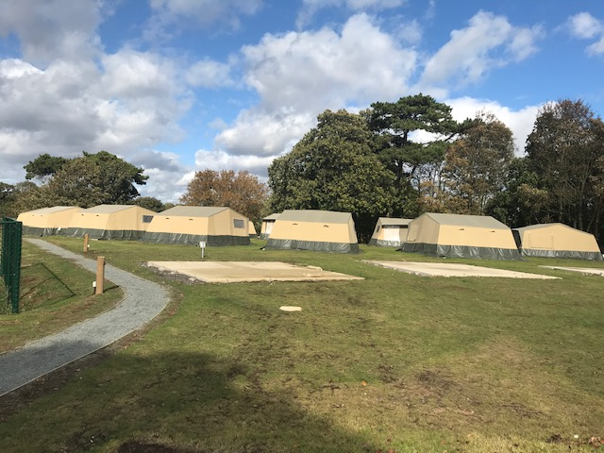
The Accommodation
Each tent sleeps 8 children – boys and girls separate – Staff tents are also in the same camp.
Toilet/Shower block very close.
Bring your own pillow and sleeping bag.

Slide 5
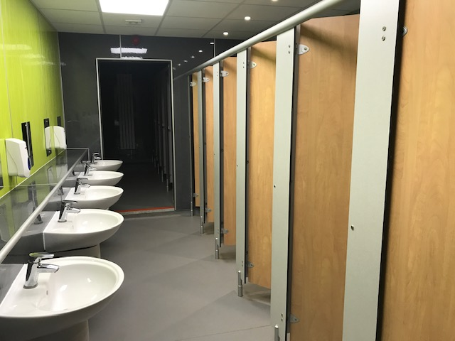
The Accommodation

Slide 6
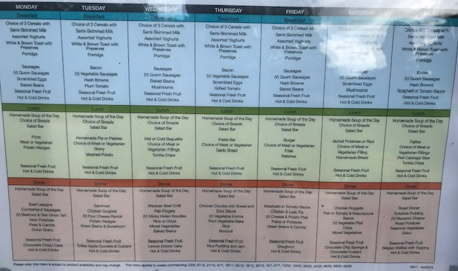
The food

Slide 7
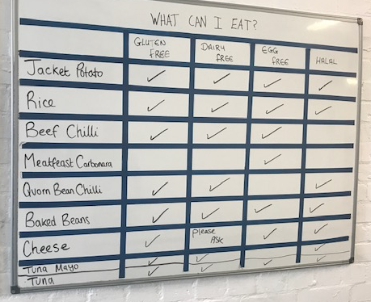
The food

Slide 8
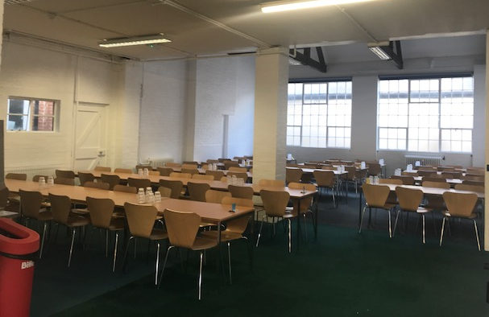
The food

Slide 9
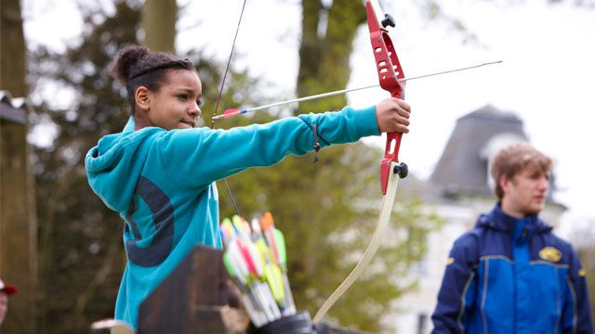
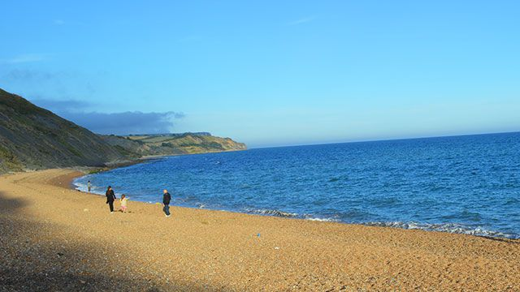
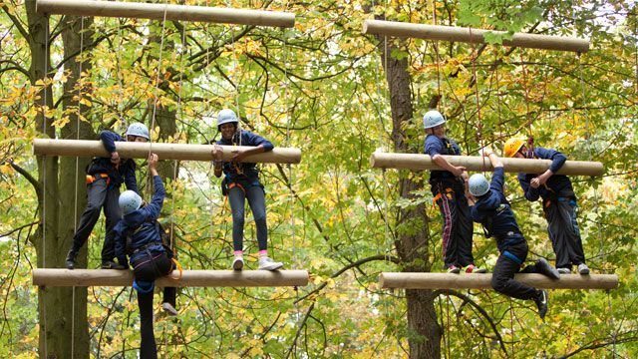
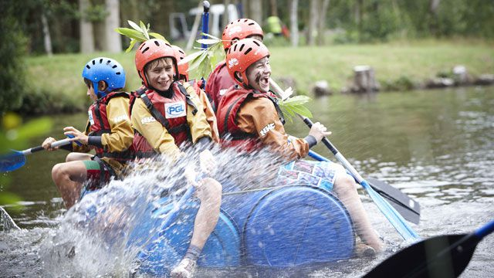
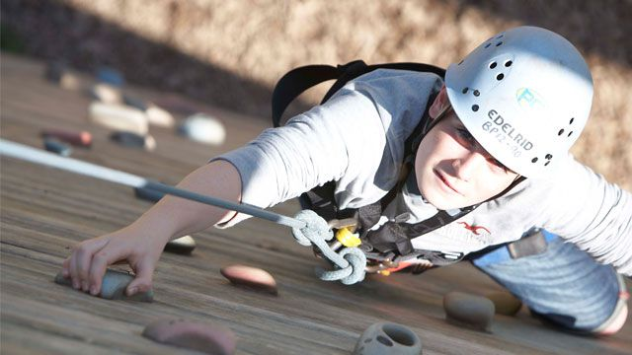
The Activities
Archery
Air rifles
Orienteering
Buggy Building
Climbing Wall
Shoreline Walk
Aeroball
Zip line
Giant Swing
Raft Building
Fencing
Survival Skills
Jacob’s Ladder
Pole Climb
Challenge (Assault) Course
Problem Solving
Sports and Team Games
Sensory Trail
4 activities per day + evening activities
(e.g. disco, talent show, wide games)

Slide 10
The activities

Slide 11
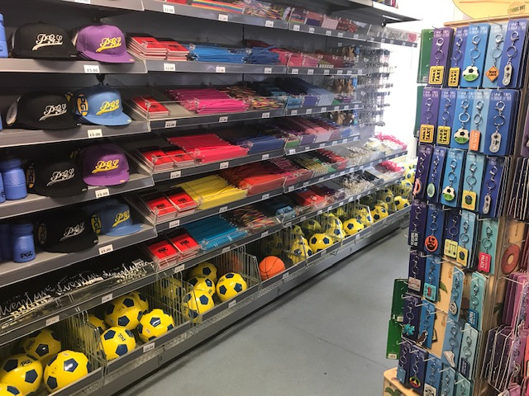
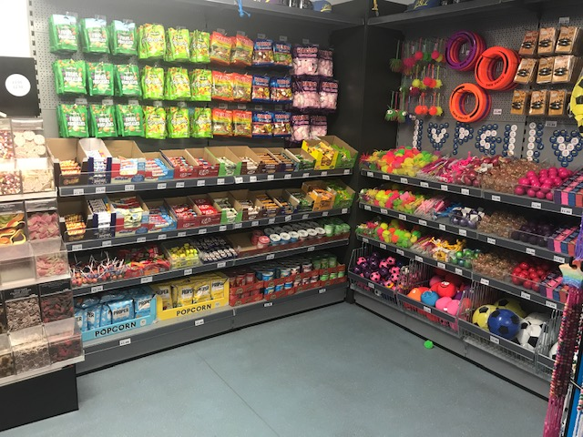
Shop

Slide 12
Staffing
The Year 6 Teachers – Mrs Harries, Mr. Rix, Mr Plowman.
Our accommodation is in the same area as the children.
Addition adults – TBA dependent on numbers/needs
Groups will have a full-time PGL member of staff with them.
There is a PGL member of staff on duty throughout the night.

Slide 13
Kit List
Sleeping Bag/Pillow
2 changes of clothes – long sleeves/trousers preferred
Nightwear
Sunhat/cap/Suncream
Torch
Washkit/towel
Trainers
Flip-flops, Slides, Crocs
Insect Repellent*
Waterproof jacket
Book/colouring book/crafting
No electronic items – e.g. consoles, mobiles, digital cameras or anything valuable
Money - £10 – Will be distributed by staff daily

Slide 14
Benefits
Challenges
Physical Activity
Independence
Team-Building/Friendship
Learning new skills
Develop new interests
Find out about our locality
A change from the academic timetable

Slide 15
Departure
Cost
Approximately £240 – Final figure TBA dependent on numbers/ coach prices
£50 non-refundable deposit by 11.10.19
Balance to be paid off in instalments/lump sum.
We will be leaving for Bawdsey at 10:30 because we can’t move into the accommodation until around midday.

Slide 16
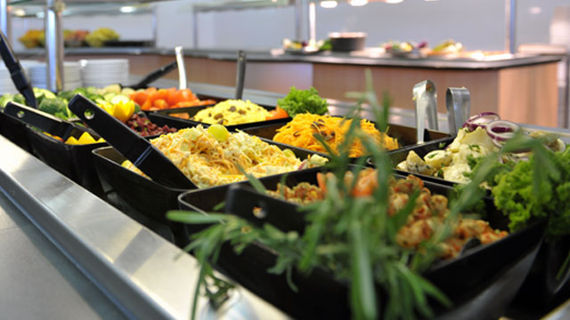
If my child doesn’t go?
Children will come to school as normal and will be put together in 1, 2 classes – dependant on numbers.

Slide 17
Questions?

